Slide 1


Predicting Financial Markets Based on Major Events Using ML & Big Data
Rajvirsinh Parmar, Western University

Slide 2
Abstract & Introduction
This thesis explores predicting S&P 500 direction using machine learning and global event data from GDELT. Traditional models often miss the immediate impact of geopolitical and social events. We integrate structured news data (event frequency, sentiment, impact) with S&P 500 daily prices.
Our XGBoost model, using lagged and sentiment features, shows minor but significant improvements over technical-only methods, highlighting the predictive power of news-based characteristics. This study demonstrates how structured event data can enhance short-term market forecasting.

Slide 3



Literature Review: News & Sentiment
News Sentiment
Machine Learning
Structured Data
Media tone can predict market returns, especially short-term investor behavior.
Algorithms classify financial news to forecast abnormal stock returns.
Shift from unstructured text to structured event datasets like GDELT.
GDELT provides structured metadata on global events (type, location, intensity, sentiment) from thousands of news sources, enabling scalable analysis.

Slide 4

GDELT in Financial Applications
GDELT, initially for political prediction, now aids financial modeling.
High-impact events (GoldsteinScale) and sentiment shifts (AvgTone) correlate with increased stock market volatility.
Structured event data, combined with deep learning, improves stock price movement forecasts.
AZFinText program uses news headlines for intraday stock price predictions.
Limitations:
Prior models often rely on complex NLP or focus on company-specific events, overlooking macro global events. Few studies directly use structured global event metadata for index-level forecasting.

Slide 5
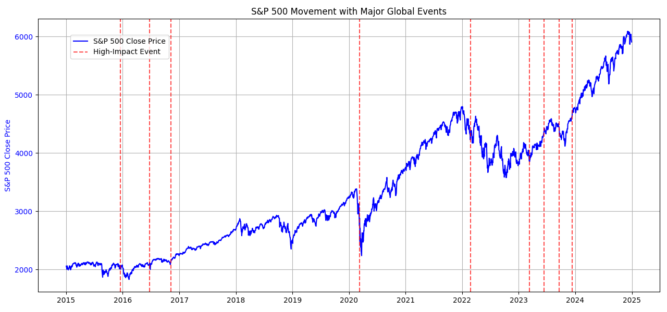
Market Movement During Major Global Events
Figure: S&P Close Price over time with high impact global events marked in red (elections, pandemics, war, invasions etc.)

Slide 6
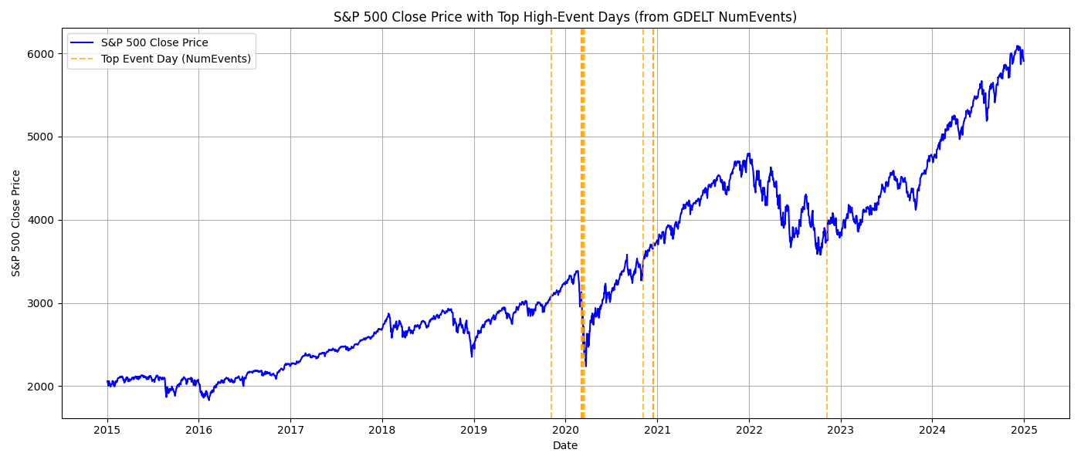
Market Response to High GDELT Event Days
Figure: Top 10 GDELT High event days (Numevents) overlaid on S&P500 close prices. These days represent globally significant media coverage days.

Slide 7
Data & Methodology
Data Sources
1
S&P 500 historical data (Yahoo Finance) and GDELT event data (impact, sentiment, counts).
Feature Engineering
2
Extracted mean AvgTone, sum/mean GoldsteinScale, daily event count, and lagged S&P 500 returns.
Target Variable
3
Binary target: 1 for positive next-day return, 0 for negative/zero.
Data Merging
4
GDELT merged with S&P 500 by date; missing data filled with zeros.

Slide 8
Model & Training: XGBoost
Why XGBoost?
Train-Test Split
High performance & regularization.
80% training (older dates), 20% testing (recent dates) for realistic forecasting.
Feature importance insights.
Handles missing data & efficient for large datasets.
Data Preparation
Feature Importance
Normalized numeric variables.
Mean GoldsteinScale, AvgTone, Event Count, and Lagged Market characteristics were most influential.
Binarized S&P 500 returns for target variable.
Ensured no look-ahead bias.

Slide 9
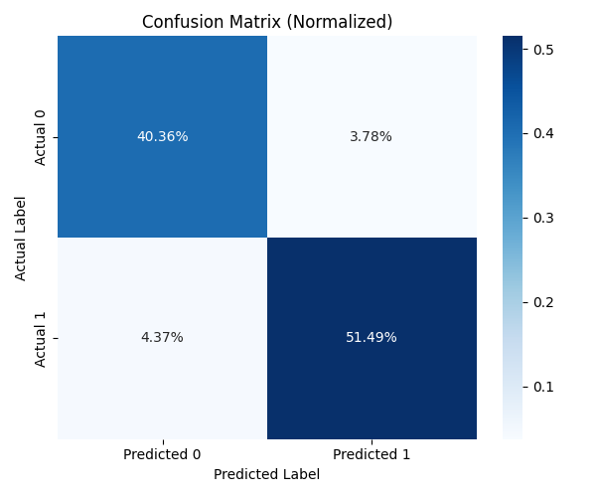
Performance Of the Model
Model Output
Accuracy: 91.8%
Precision (up days): 93%
Recall (up days): 92%
F1-score (Class 1): 93%
Confusion Matrix
True Positives: 259
True Negatives: 203
False Positives: 19
False Negatives: 22

Slide 10



Discussion & Practical Implications
Our model's 91.8% accuracy suggests structured global event data significantly enhances short-term financial market forecasts, especially for positive market movements.
Signal Generation
Risk Management
Market Sentiment
GDELT features can augment quantitative trading strategies.
Identify volatile days to adjust portfolio exposure.
Monitor AvgTone for shifts in global market mood.
This approach is efficient, bypassing complex NLP for real-time scalability.

Slide 11
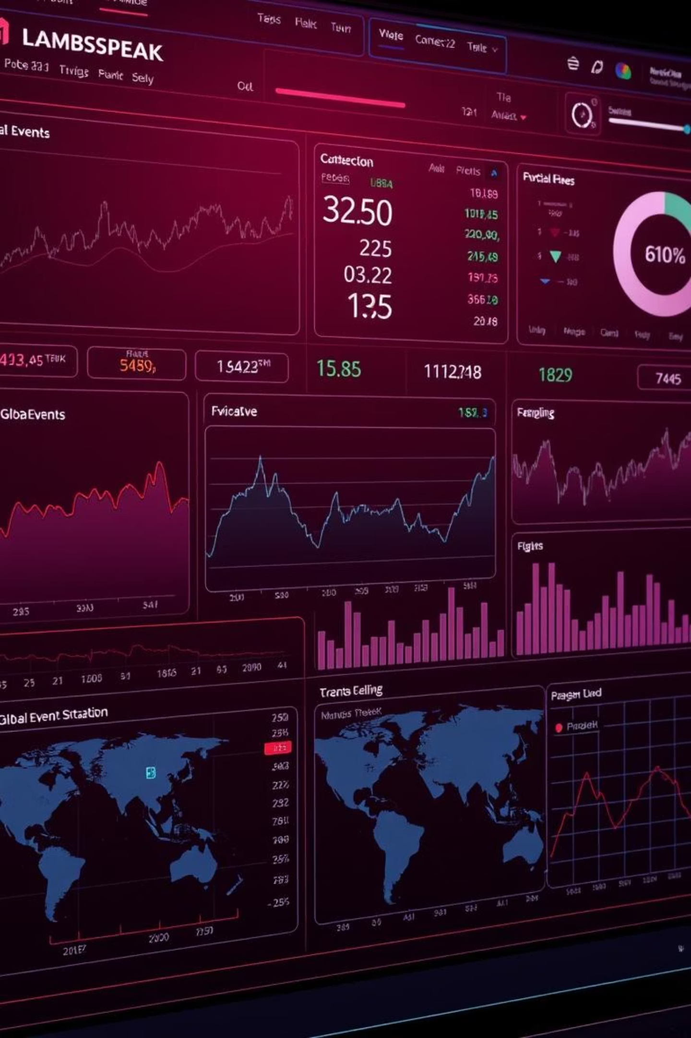
Conclusion & Future Directions
Structured global event data from GDELT significantly improves S&P 500 short-term directional forecasting, achieving over 91% accuracy. This method avoids complex NLP, making it efficient and scalable.
Future research can explore multi-class classification, fine-grained event types, time-lagged features, cross-asset analysis, and hybrid models combining GDELT with NLP. Real-time dashboards could provide immediate trading signals.

Slide 12
THANK YOU FOR LISTENING.

